Slide 1
SYN413 - Microsoft Containers in a Citrix World
#SYN413 #citrixsynergy

Slide 2
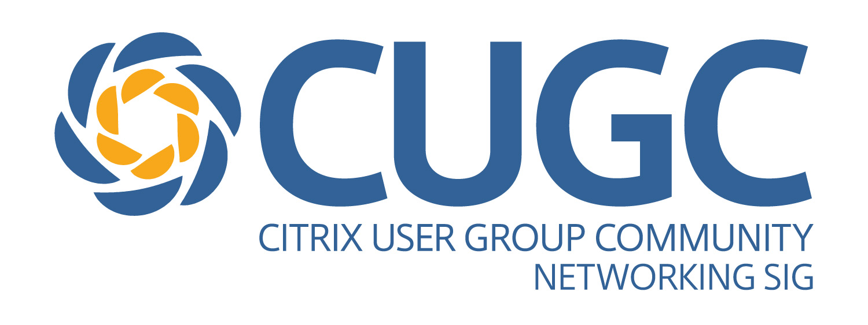

Mike Nelson
Infrastructure Architect
Citrix CTP
Microsoft MVP
Microsoft Azure Advisor
VMware vExpert
@nelmedia
nelmedia@gmail.com

Slide 3
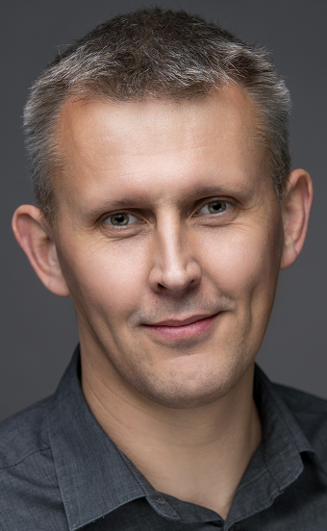
Andy Wood
Principal Architect
Citrix CTP
VMware vExpert
Ceng
CITP
@andymwood
www.gilwood-cs.co.uk

Slide 4
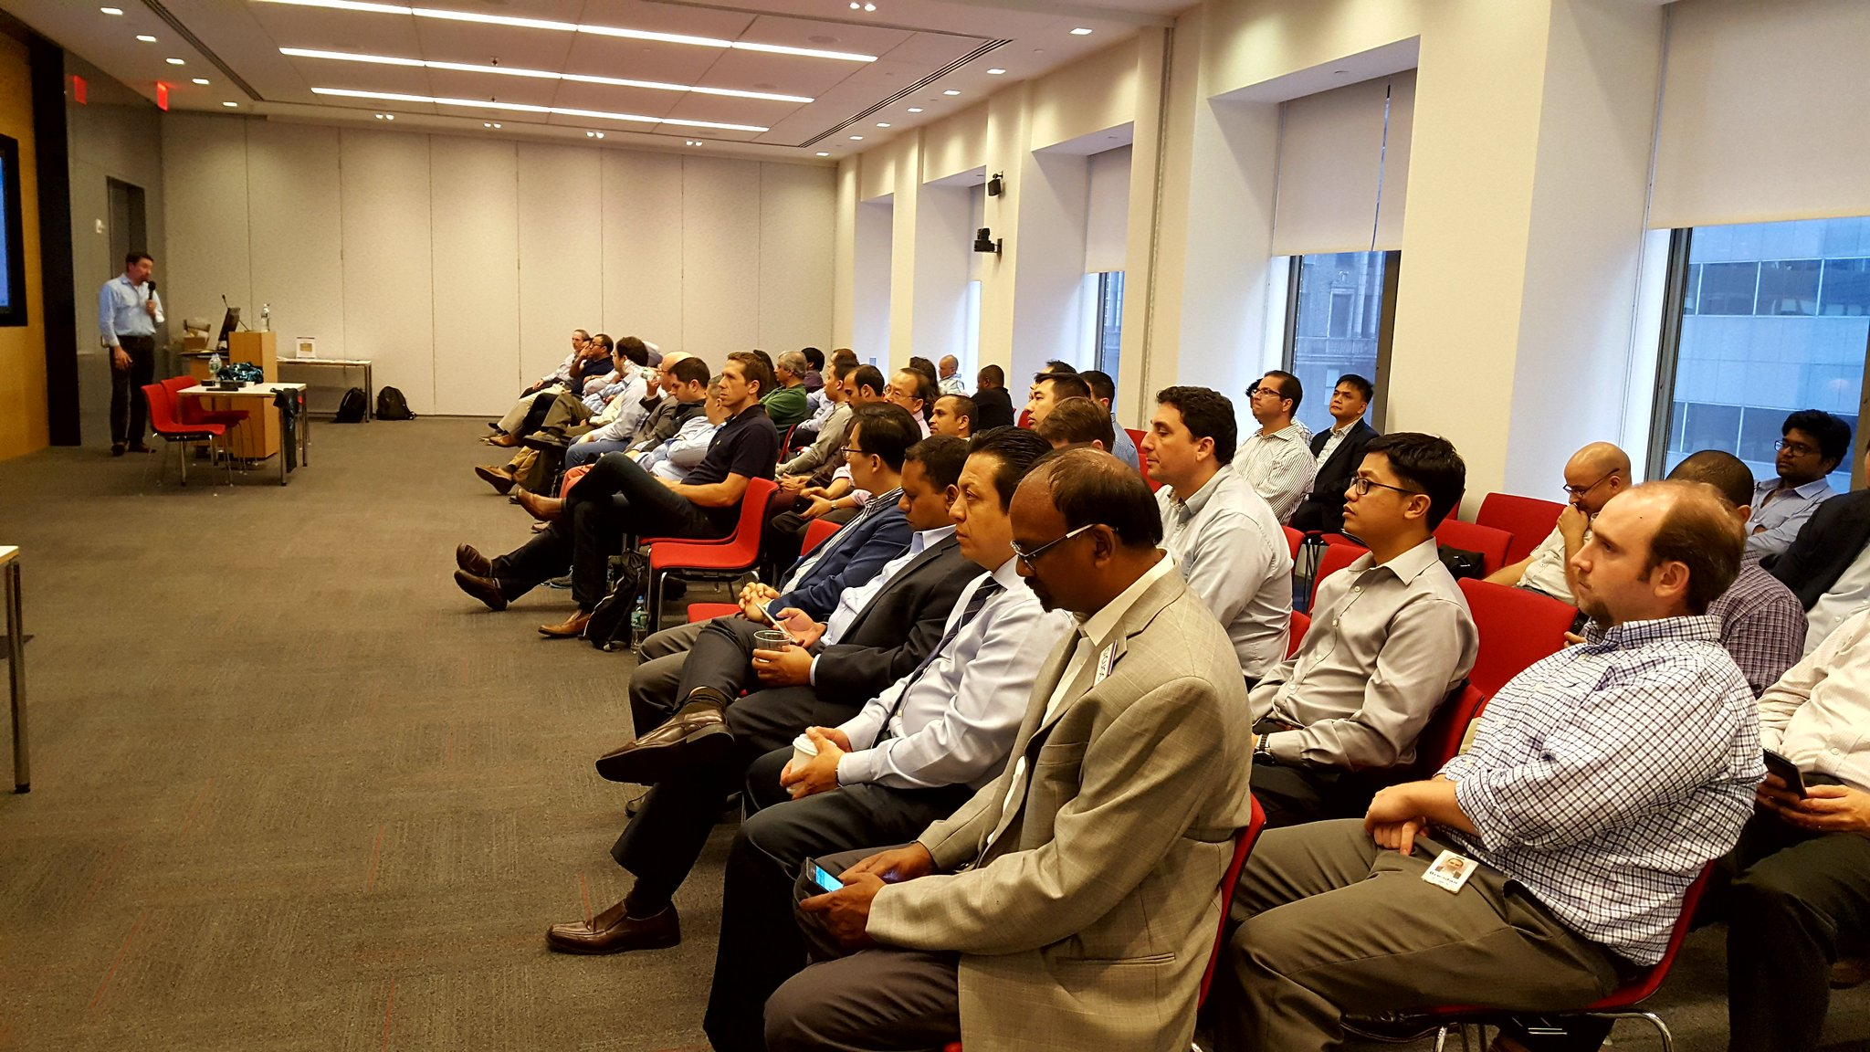
For the users, by the users
16,000+ members globally
60+ local user groups and special interest groups (SIGs)
Knowledge sharing, expert discussion
Networking at local meetings, conferences and technology events
Technical webinars, forums and blogs
Opportunities to share, learn, mentor and lead
“It was an opportunity to bring together like-minded people, network,
share stories, and help each other.” – CUGC Member

Slide 5

Before you leave…
Conference Surveys are available via email and in the Synergy Mobile app starting Thursday, May 25 at 9:00 a.m. ET
Those who provide feedback by Friday, May 26 at 6:00 p.m. ET will receive a $20 Amazon e-gift card
Watch sessions on demand beginning Friday, June 2 at www.citrix.com/SynergyTV
Download presentations starting Friday, June 9 from your My Synergy Account

Slide 6
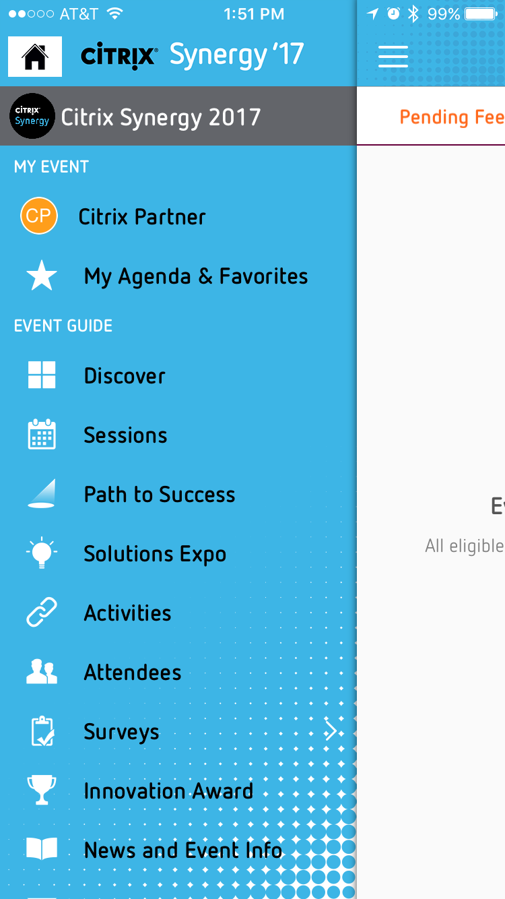
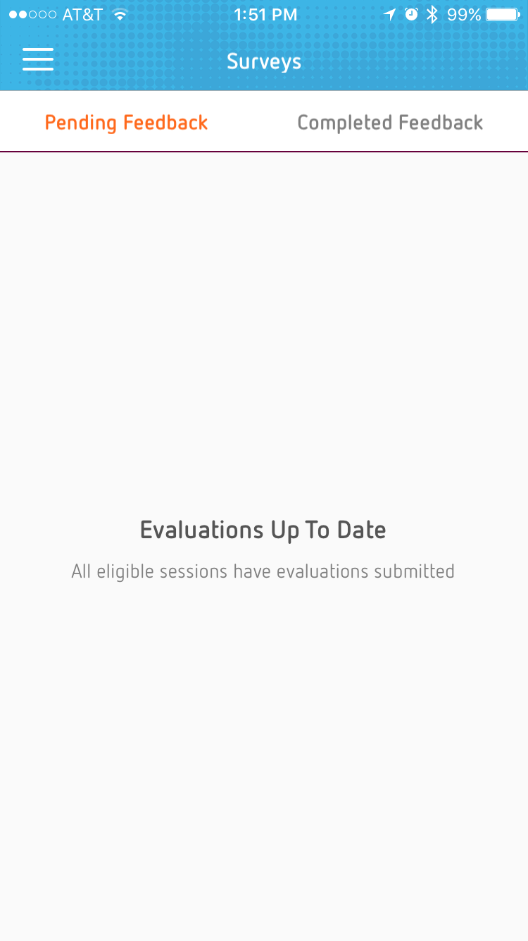
Rate this session in the mobile app
Surveys are based on entrance scanning
Once you scan in to a session, that session will pop up on the mobile app
Complete the survey on the mobile app
The mobile app will show you pending feedback and completed feedback
Pending – surveys to take
Completed – completed surveys

Slide 7
Topics
Windows and Docker
Containers and Citrix
Some Alternatives

Slide 8

Notes:
The new Windows Containers logo

Slide 9
Why Are YOU Here?
DevOps or ITPro?
“As a system Administrator, one of the scariest things I ever encounter is a server that has been running for ages.
If you absolutely know a system has been created via automation and never changed since the moment of creation, most of the problems disappear.”
- Chad Fowler, Trash Your Servers and Burn Your Code, 2013

Slide 10
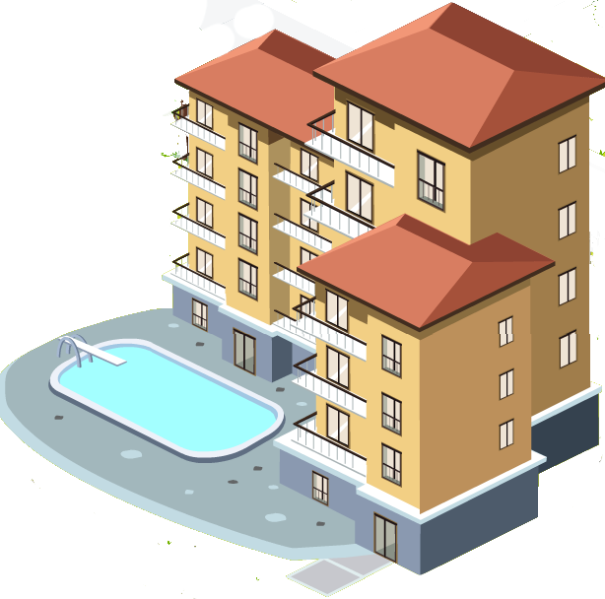

VMs and Containers
VM’s
Containers
“Will containers replace VM’s?”
No.
Containers are not a virtualization technology.
Containers are an application deployment & delivery technology.

Slide 11
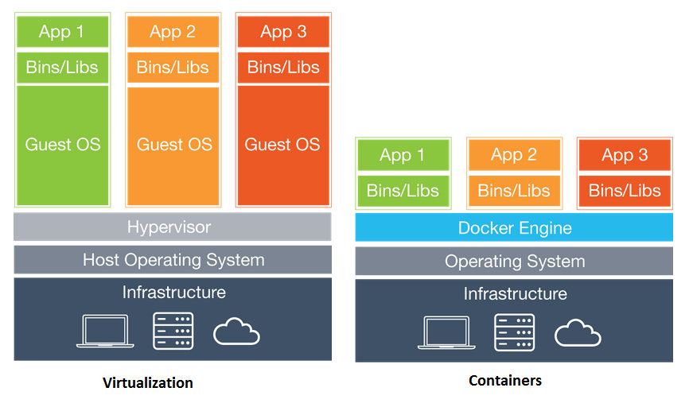
Notes:
Build versions limitations

Slide 12
A Microsoft View of Containers
Containers = Operating system virtualization
Windows Server Containers
Maximum speed and density
OS
CONTAINER
CONTAINER
CONTAINER
CONTAINER
CONTAINER
CONTAINER
Applications
Kernel
Kernel
Hardware
Hyper-V Containers
Isolation plus performance
Traditional virtual machines = hardware virtualization
Application
VM
VM
VM
CONTAINER
CONTAINER
CONTAINER
OS
Kernel
Kernel
Kernel
Hardware
Hyper-V

Slide 13
Windows Containers – It’s All About User Mode
Host User Mode
Virtual Machine Specifically Optimized To Run a Container
System Processes
Container Management
Session Manager
Hyper-V Container
Docker Engine
Local Security Authority
Windows Server Container
Windows Server Container
Compute Services
Etc…
System Processes
Application Process(es)
System Processes
Application Process(es)
Windows Kernel
Windows Kernel

Slide 14
Windows Server & Hyper-V Containers Mix
Linux Container
Linux Container
Linux Container
Linux Container
Hyper-V Container
Hyper-V Container
Hyper-V Container
Hyper-V Container
Windows Server Container
Windows Server Container
Linux Container
Linux Container
Linux Container
Linux Container
Linux Container
Windows Server Container
Windows Server Container
Hyper-V
Hyper-V
Server 2016
Windows 10
Linux
Hyper-V
Hyper-V
Physical / Azure / Azure Stack
Hyper-V = Different OS Releases and Builds
Server OS = Release version must be the same, while Build version can be different

Slide 15
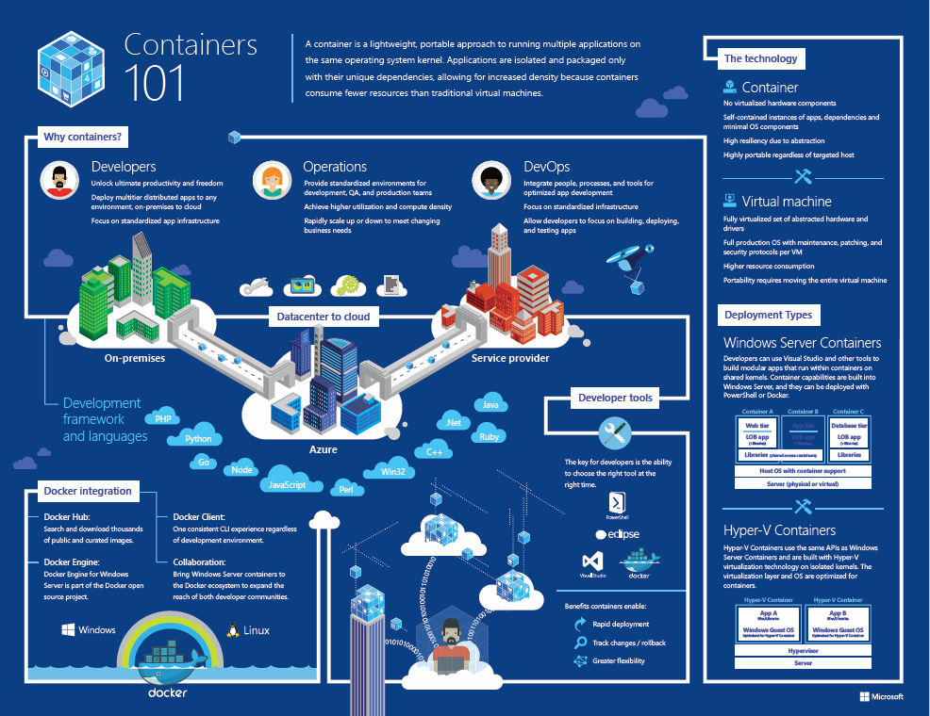
www.microsoft.com/en-us/cloud-platform/containers
www.microsoft.com/en-us/cloud-platform/containers

Slide 16
“Linux is a malignant cancer that attaches itself in an intellectual property sense to everything it touches”.
- Steve Ballmer 2011
“If you don’t jump on the new, you don’t survive”.
- Satya Nadella 2014
App Porting
GitHub
SQL
PowerShell
Linux in MS Corporate
Visual Studio
bash shell
Linux on Azure

Slide 17
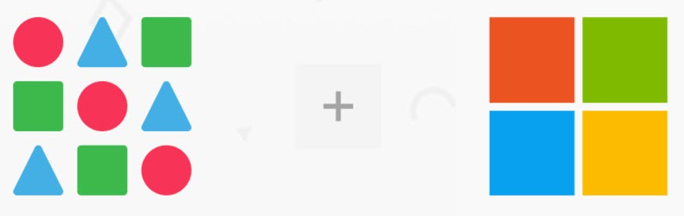

Microsoft’s Container Investments
Mesosphere
DEIS - Tools for Kubernetes
OMS Integration
Dedicated Team

Slide 18
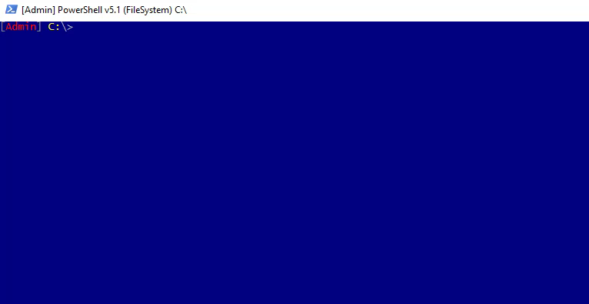
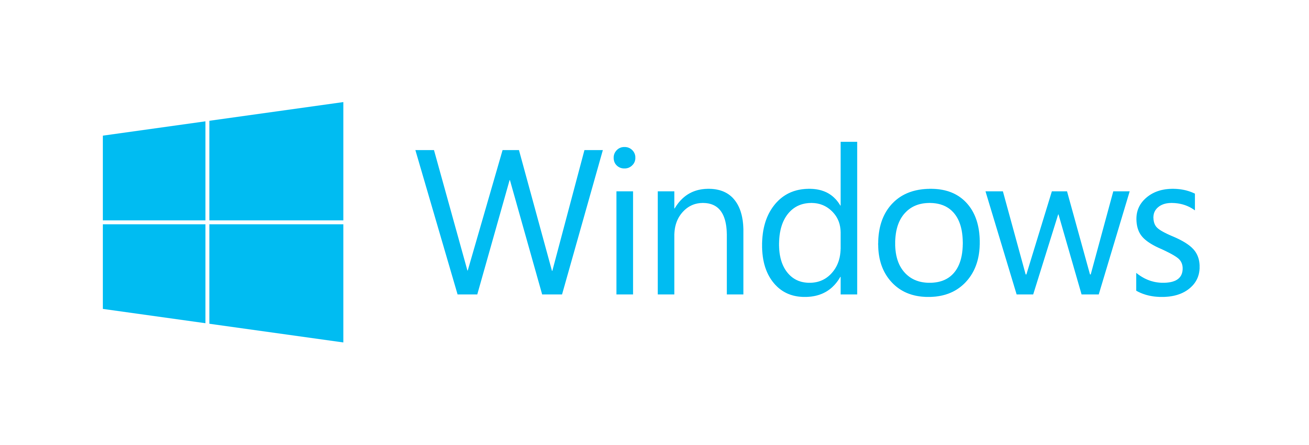

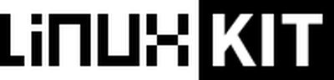
Dockercon 2017
+
+
Notes:
LinuxKit
Secure, Lean, & Portable Linux subsystem
Tooling to build custom Linux subsystems that only includes exactly the components the runtime platform requires
~35MB in size, very quick start
All system services are containers and can be removed or replaced
Will most likely start as a feature element of Windows Server and grow into a native service.
Follows NIST draft of Application Security Guide

Slide 19

LinuxKit
Secure, Lean, & Portable Linux subsystem
Tooling to build custom Linux subsystems that only includes exactly the components the runtime platform requires
~35MB in size, very quick start
All system services are containers and can be removed or replaced
Will most likely start as a feature element of Windows Server and grow into a native service.
Follows NIST draft of Application Security Guide

Slide 20
Using Containers
Can I run the “Control Plane” in Containers?
How about Desktops?
And then there are the apps.

Slide 21


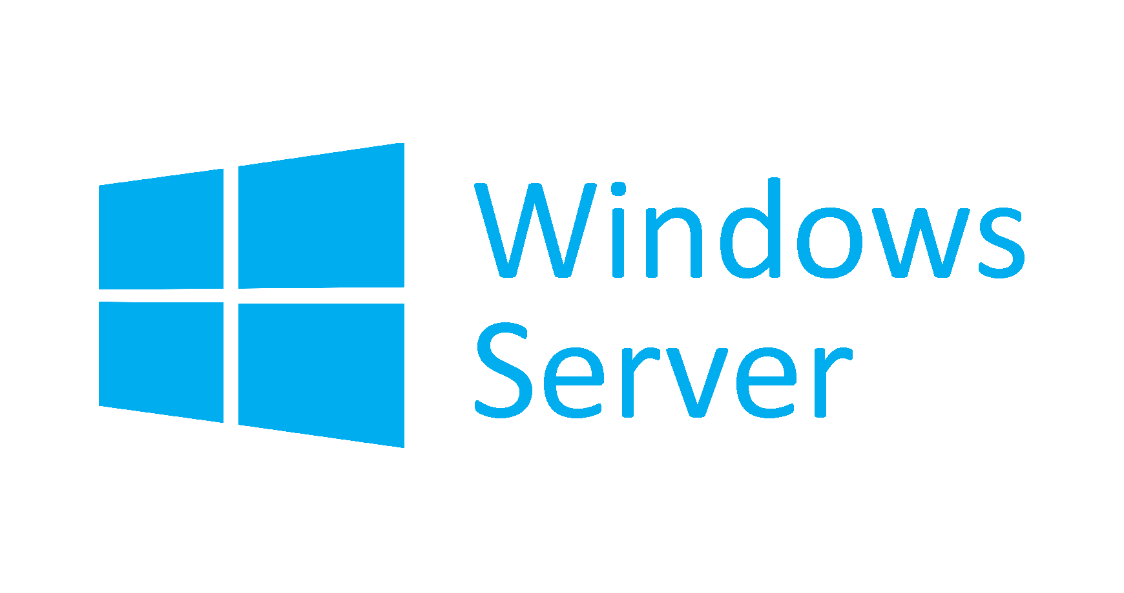
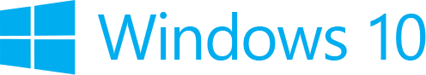
+
+
NanoServer
Core

Slide 22
Docker on Windows
Server Core & Nanoserver only (for now…)
Management
Built-In Docker CLI & PowerShell
Kitematic, Portainer, Panamax, Simple Docker UI, Shipyard (Linux)
Public or Private Hubs & Registries
Windows 10 for DEV/Test

Slide 23
Install Demo
Docker for Windows 10 & Server 2016

Slide 24


Slide 25
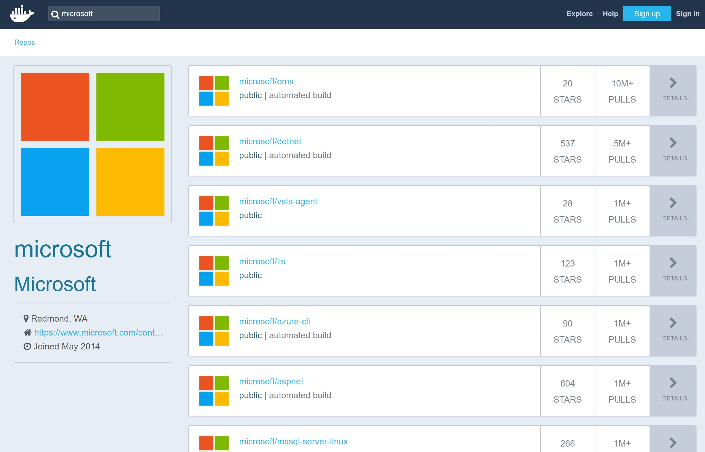
Linux Containers
Windows Containers
Build Version Limitations

Slide 26
Windows Containers & GUI Apps
GUI
Notes:
Windows Containers rely on user space isolation implemented in the kernel (beginning with Windows Server 2016). While this allows for a more effective isolation, this only addresses server applications and does not allow for the graphical user interface of an end user applications to be presented.

Slide 27
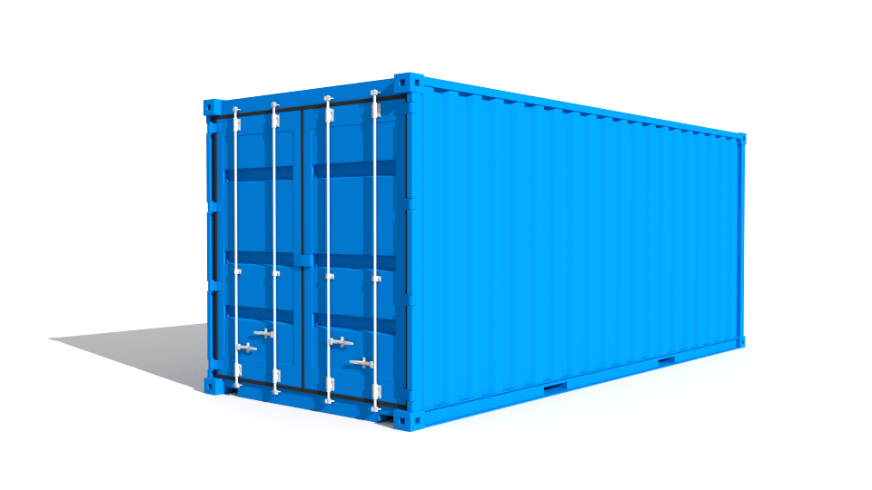


Containers Running XenDesktop & XenApp
Control Plane
SQL
License
Director
DDC
Studio
Optional
https://www.youtube.com/watch?v=uIEJCQDajWw
Storefront
Netscaler
XenApp
XenDesktop
Apps

Slide 28
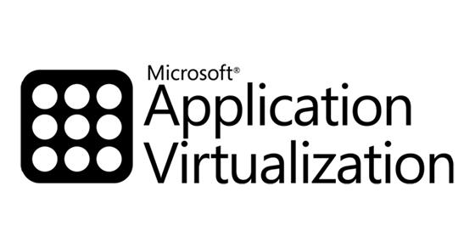
“… Docker containers does encapsulate all the code and libraries necessary to run a service. But those services are fundamentally different than the applications that are delivered via traditional application virtualization technologies.
In the end Docker is not a direct replacement for application virtualization. It’s a way to take many of the applications deployed using app virt technologies and recreate them in a manner that offers higher levels of agility, portability, and control.” – Mike Coleman, Technical Evangelist @ Docker

Slide 29
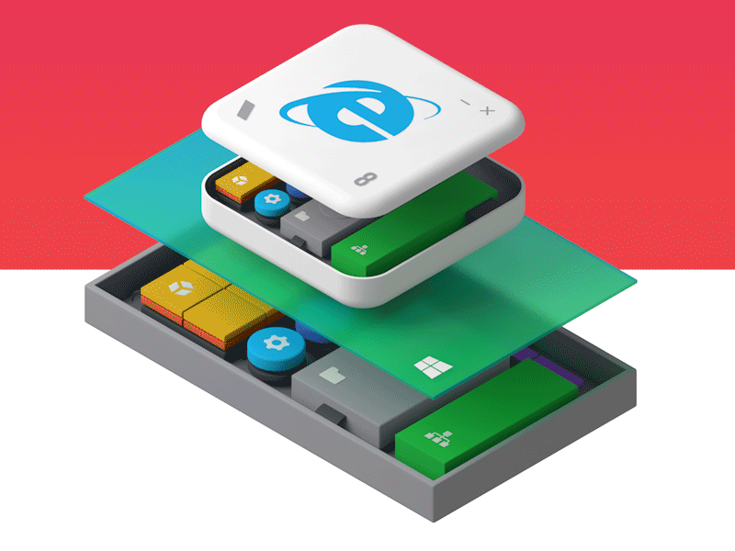
Notes:
Liquidware, ThinApp, etc.

Slide 30
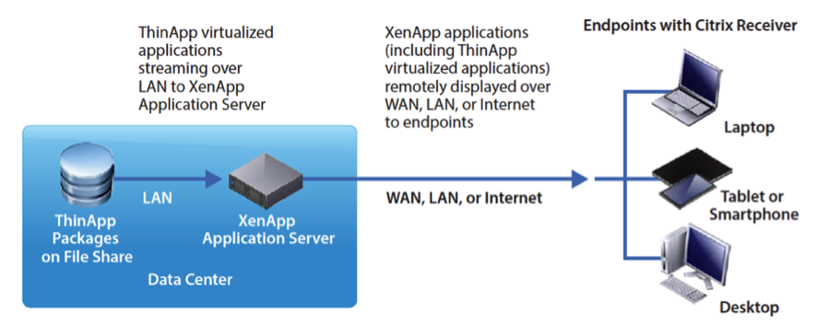
VMware Thinapp

Slide 31

“Containers” similar to Docker
Pre-made or custom images
CLI, Turbo Studio, Turbo Server
Updating & Layering
Importing from other formats
Container “skinning” & streaming
Desktop & server apps – XP to 2016 & beyond
turbo.net
Turbo Studio
Virtualize app into EXE & publish - manual or via Register utility
Register utility allows for app to be placed on machine or share & in 7.x it will appear in Citrix Studio Wizard
Spoon.net
“Docker for Windows”
- Rory Monaghan 2014
“XenApp Subscription”
Channel -> Subscribe -> Publish
XenApp Tools to automate setup are provided
https://github.com/turboapps/citrix
www.xenappblog.com

Slide 32
Turbo.net Demo

Slide 33
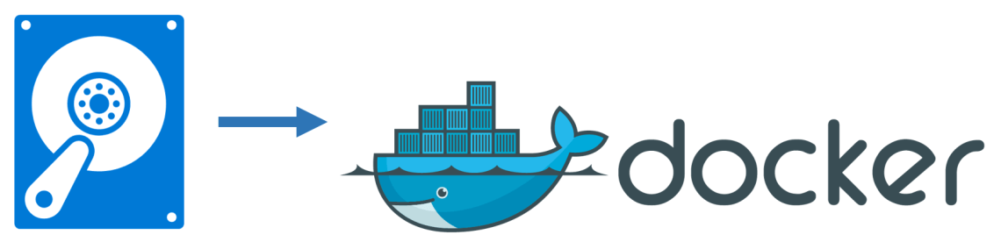
Image2Docker
PoSH module that ports existing Windows app artifacts from VM’s to Docker images
Artifacts currently supported –
IIS
ASP.NET
MySQL, SQL
Windows Features
Apache
DHCP
DNS
MSMQ
Discover -> Extraction -> Provisioning -> Generation

Slide 34
Containers are not VM’s (and never will be)
OS & GUI Limitations
Use Win 10 Docker for Dev/Test
There are alternatives for delivering apps
Windows + LinuxKit = Multi-Platform
Containers are about User Mode
Hyper-V for secure container isolation
Citrix needs to support Core

Slide 35
Thank You!

